Slide 1
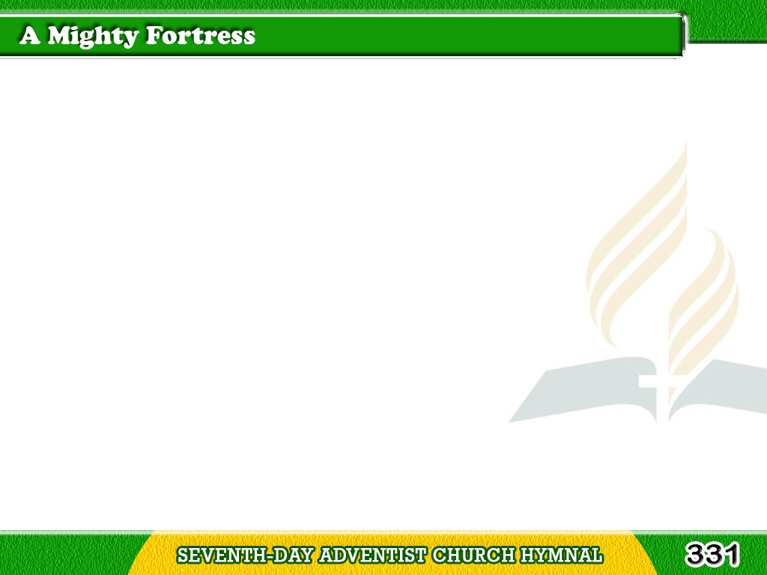
1/4
A mighty fortress is our God,
A bulwark never failing;
Our helper He, amid the flood
Of mortal ills prevailing.
For still our ancient foe
Tagalog
Version

Slide 2
1/4
Doth seek to work us woe;
His craft and power are great;
And armed with cruel hate,
On earth is not his equal.
Tagalog
Version

Slide 3
2/4
Did we in our
own strength confide,
Our striving would be losing,
Tagalog
Version

Slide 4
2/4
Were not the right man
on our side,
The man of God’s own choosing.
Dost ask who that may be?
Tagalog
Version

Slide 5
2/4
Christ Jesus, it is He,
Lord Sabaoth His name,
From age to age the same,
And He must win the battle.
Tagalog
Version

Slide 6
3/4
And though this world,
with devils filled,
Should threaten to undo us,
Tagalog
Version

Slide 7
3/4
We will not fear,
for God hath willed
His truth to triumph through us.
The prince of darkness grim,
Tagalog
Version

Slide 8
3/4
We tremble not for him;
His rage we can endure,
For lo! his doom is sure,
One little word shall fell him.
Tagalog
Version

Slide 9
4/4
That word above all
earthly powers,
No thanks to them,
abideth;
Tagalog
Version

Slide 10
4/4
The Spirit and the gifts are ours
Through Him who with us sideth;
Let goods and kindred go,
Tagalog
Version

Slide 11
4/4
This mortal life also;
The body they may kill;
God’s truth abideth still,
His kingdom is forever.
Tagalog
Version

